Slide 1
Disclaimer
All the topics followed in this lecture are from Engineering Economy by R. Panneerselvam 4th Edition, which is being used as a standard textbook for this course. The data taken from the book is entirely for study purposes and no copyright infringement is intended.

Slide 2
Chapter 7
RATE OF RETURN METHOD

Slide 3
Rate of Return Method
The rate of return of a cash flow pattern is the interest rate at which the present worth of that cash flow pattern reduces to zero.
In this method of comparison, the rate of return for each alternative is computed.
Then the alternative which has the highest rate of return is selected as the best alternative.
In this type of analysis, the expenditures are always assigned with a negative sign and the revenues/inflows are assigned with a positive sign.

Slide 4
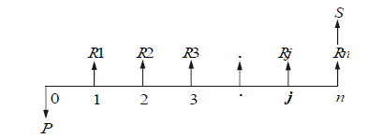
A generalized cash flow diagram to demonstrate the rate of return method of comparison is presented in the Figure:

Slide 5

The first step is to find the net present worth of the cash flow diagram using the following expression at a given interest rate, i.

Slide 6
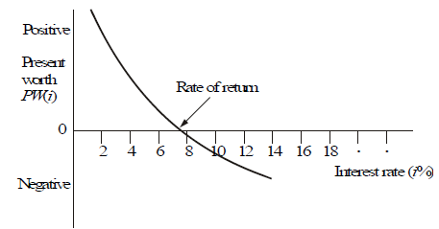
So, one has to start with an innate value of i and check whether the present worth function is positive. If so, increase the value of i until PW(i) becomes negative.
Then, the rate of return is determined by interpolation method in the range of values of i for which the sign of the present worth function changes from positive to negative.

Slide 7
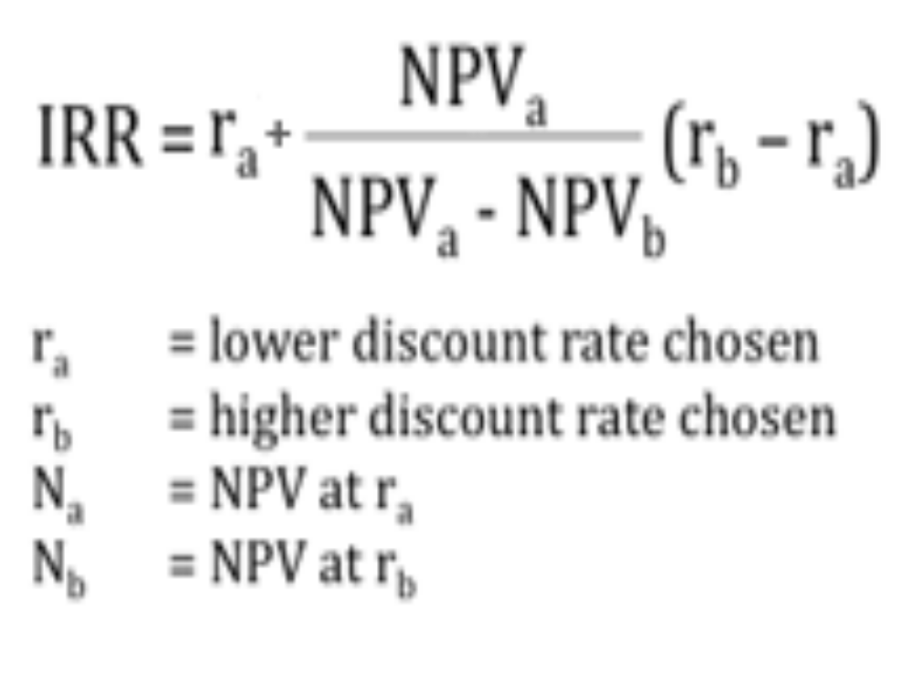
Formula

Slide 8
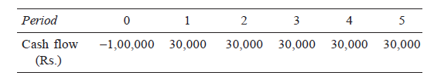
Example 1
A person is planning a new business. The initial outlay and cash flow pattern for the new business are as listed below. The expected life of the business is five years. Find the rate of return for the new business.

Slide 9
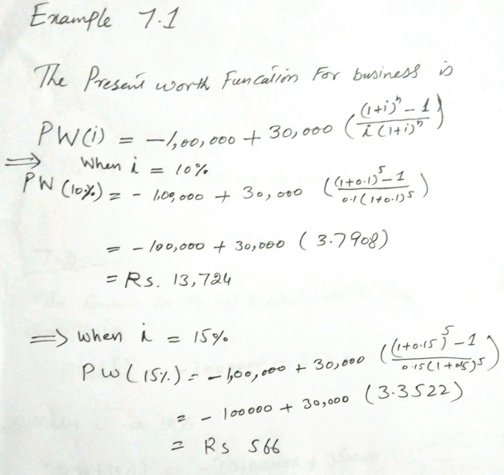

Slide 10
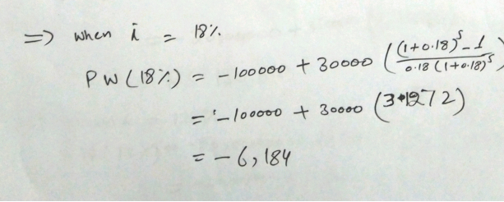
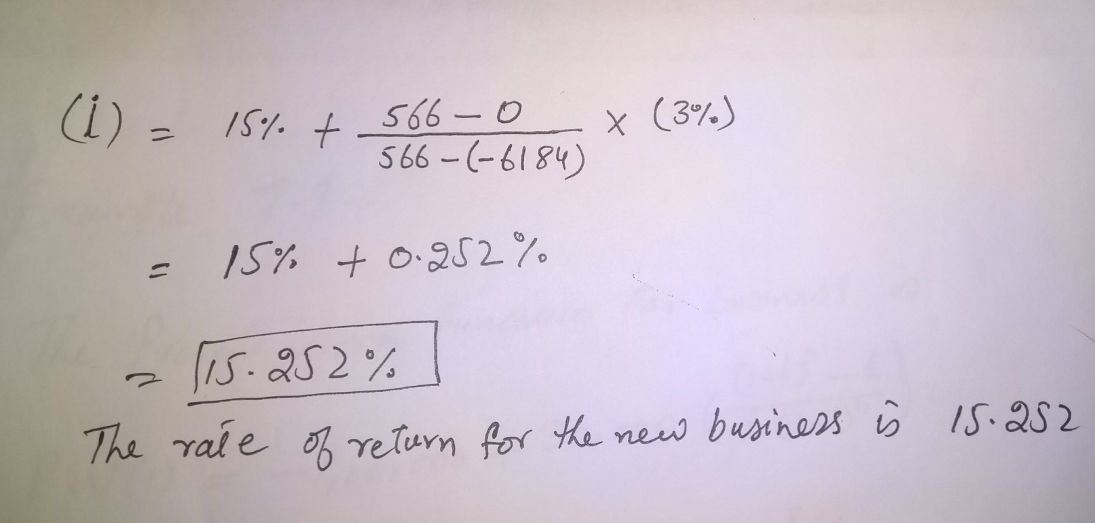

Slide 11
Example 2
A company is trying to diversify its business in a new product line. The life of the project is 10 years with no salvage value at the end of its life. The initial outlay of the project is Rs. 20,00,000. The annual net profit is Rs. 3,50,000. Find the rate of return for the new business.

Slide 12
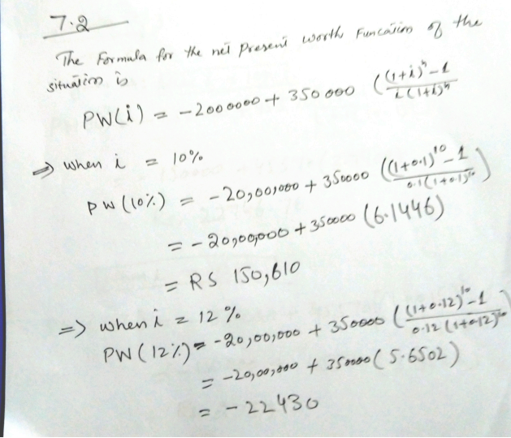

Slide 13
